Slide 1
Client Profiles
A Company that You can Trust and Rely Upon
1555 County Road 25 South ∙ Bellefontaine, OH 43311 ∙ (937) 565-4910
www.purerenovations.com

Slide 2
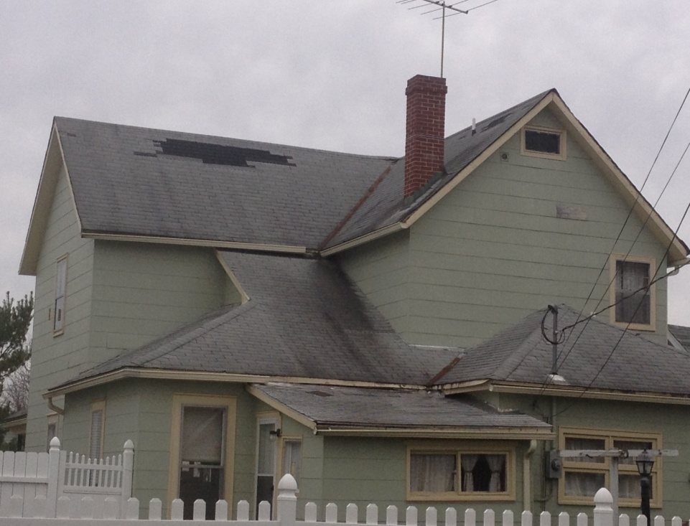
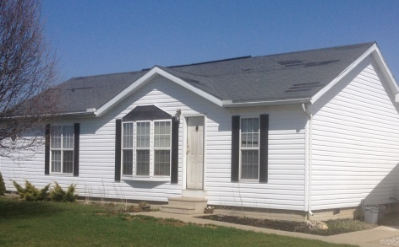
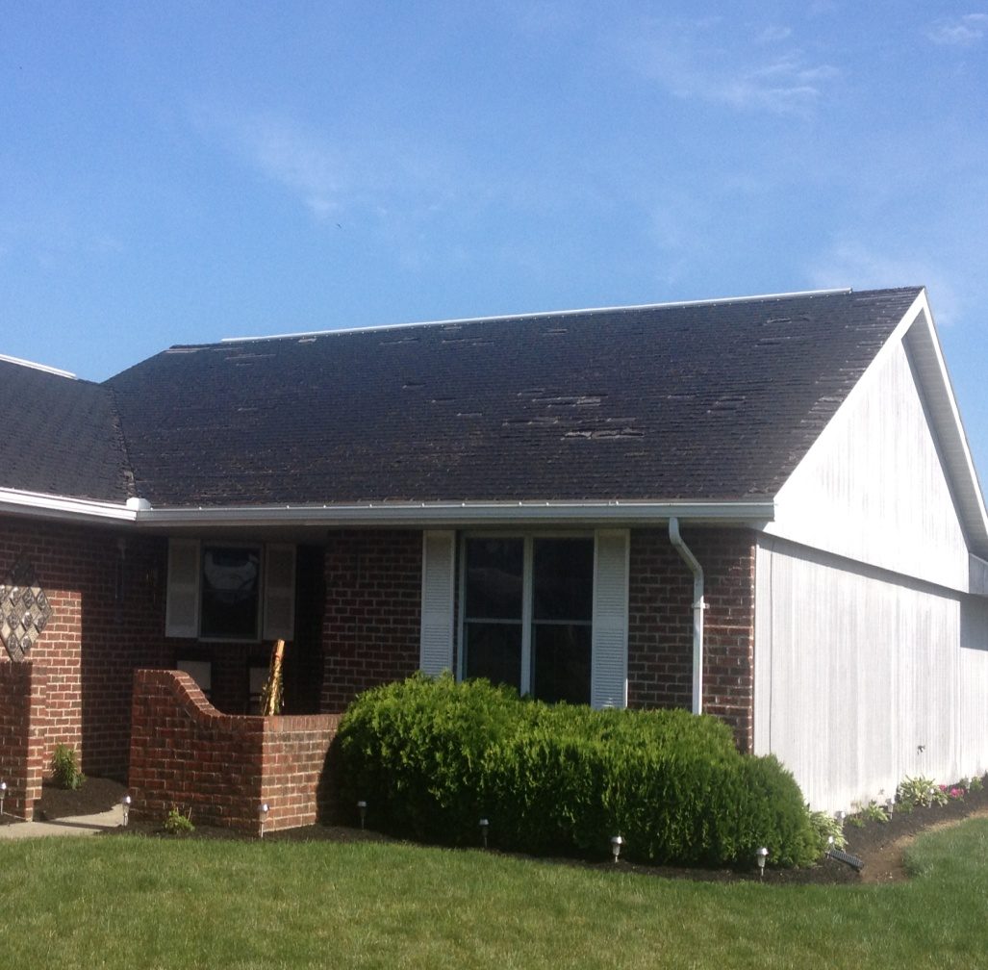
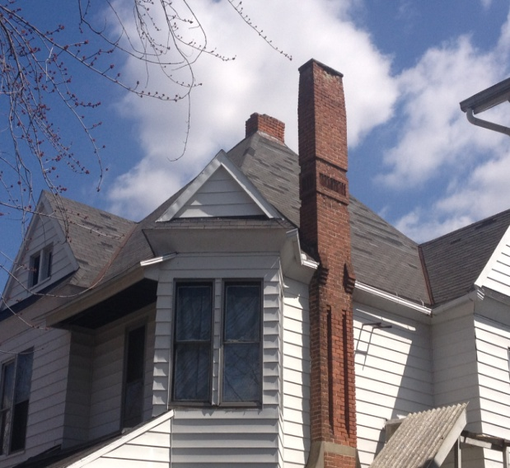
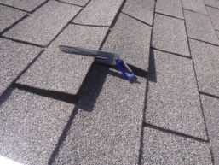
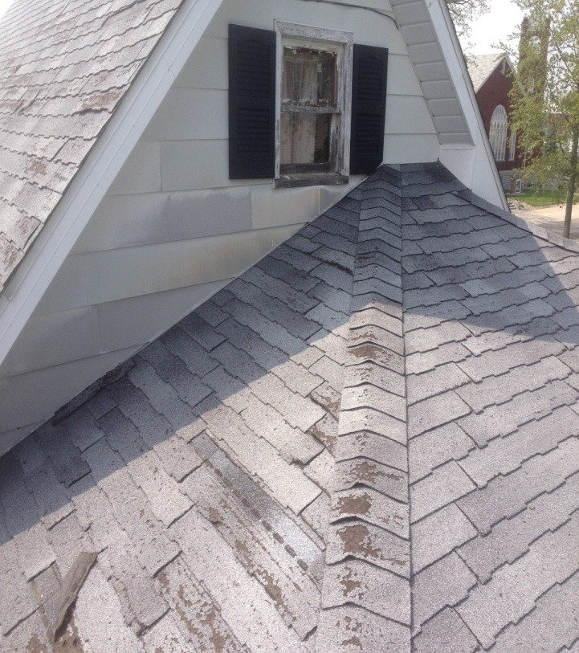
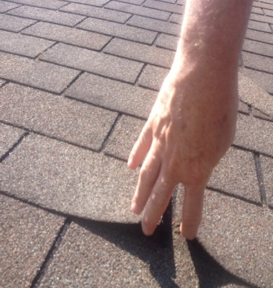
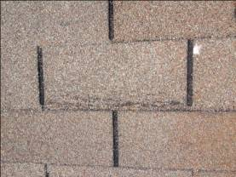
Does your roof look like any of these? If so, you have weather related damage and
need to call us.
←
Multiple shingles have blown off this roof
←
←
←
Detached shingles bend and break
Old roof
or new roof damage is
the same when a claim is filed
Duplex roof that is in
need of repair

Slide 3
Pure Renovations Provides the Following Support Services
Conducts an inspection of your home and/or place of business to guide/advise you regarding
your options and next steps. This is a free service provided to you.
Professional insurance specialists represent the property owner in assisting them when filing their
claims online or over the phone.
Make sure the home/policy owner is properly represented when working with their adjuster.
We follow up to make sure the insurance company processes your claim quickly to receive your award.
We do the repairs or replacement authorized by your insurance company according to Boca & OBBC.
Submit the proper paper work to your insurance company once the job is completed w/ certificates of
warrantees and verification pictures to insure you receive any depreciation pertaining to your claim.
Life-time warranted products are provided that are, in many cases, better than what your insurance
company covers. This too is at no extra cost to you.
Additional primary and ancillary construction services and skills available for other types of project if
needed or required.

Slide 4
The Process:
1. We discuss your situation and weather related damage regarding your property
and/or needs that you are concerned about.
You agree to allow our personnel to represent you prior to filing your claim.
We arrange a time to meet with your insurance adjuster.
Be at your place of residence or business during the inspection process.
A notification of the award is made by the insurance company and we do the work once you have picked out colors and styles.
The work is completed and we are paid for completing the insurance claim per their scope/terms of work and requirements.
Note: If by chance your insurance company issues a partial award, depending upon the type of policy you have with them, we will provide you with the necessary information, pricing, estimates and logistics to complete said repairs that you would like to address in going forward regarding your property.
Photos of project are available upon request. Call Pure Renovations 937-565-4910.

Slide 5
Clients Who Have Experienced
the Process
The following clients have allowed Pure Renovations to represent them in submitting their claims. You may call them for they have given us permission to showcase their stories and share their photos in our Pure Renovations project profiles.
Full Replacement Awards:
∙ Jon Moyer ∙ Jesus Rodriguez ∙ Shawn Huston ∙ Bill Mercer
∙ Todd Ray ∙ Christ Covenant Church ∙ Don Patton
(Additional Profiles to be added) ∙ Karen Vancalster ∙ Alisha Lomeli
Partial Supplemental Awards:
(APTBA) ∙ Donald Szallar Sr. ∙ Ruth Whitaker ∙ Tom Ricard

Slide 6
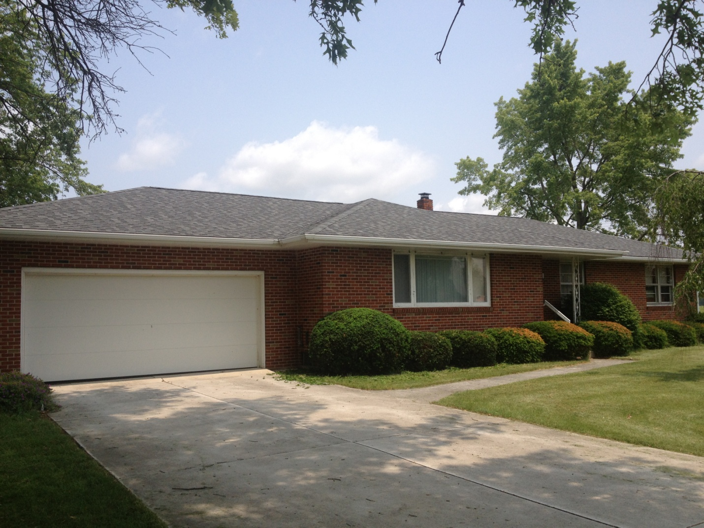
Pure Renovations
Project Profile
Home Owner's Story Reverse Side
This is an after photo
Jon Moyer
22958 County Road 216
Fostoria, Ohio 44830
Ph. # 429-8894-6440
Note: Additional photos of this project are available upon request.

Slide 7
Jon Moyer
22958 County Road 216 ∙ Fostoria, Ohio 44830 ∙ Ph. # 429-8894-6440
Jon owns Lakeside Golf Course in Fostoria and his house sets near the tee box for hole #2 at the corner of State Route 23 and County Road 216 in Hancock County. His house can be seen from all four sides. Jon was visited as
he arrived home one evening after mowing and watering his course. His roof was missing a lot of shingles and they were all over his yard. His roof had poor ventilation and the organic shingles were at the end of their
life span. However, due to the severe weather, he qualified for a new roof without any out of pocket expense.
Pure Renovations was entrusted to represent him and his claim. He was prepared to hear the word “no” and have his claim denied, which he fully expected. However, due to the location, damage and quality representation, Jon was awarded a complete, full replacement roof. Several of the golf club members and public players have inquired about his new roof and incredible story.
The crew assigned to the replacement of his roof completed the project within 8 hours. Jon and his wife were fully pleased with the service and quality of their new roof. They are telling everyone about the convenient process and friendly representation. Jon is no longer just a client, he’s our friend.
Jon’s insurance is Allstate which is the most difficult to work with regarding awarded claims. However, the day
we met with the adjustor, he was the most helpful of all adjustors ever incurred.
Note: Photos of this project are available upon request. Call Pure Renovations @ 937-565-4910.

Slide 8
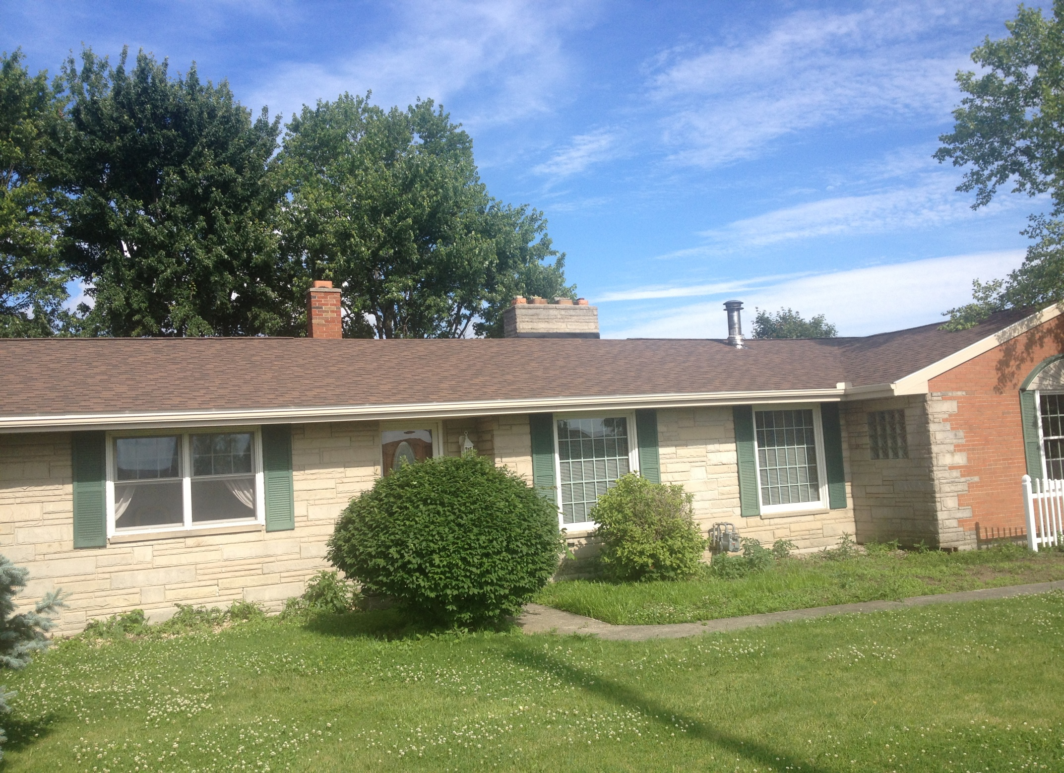
Pure Renovations
Project Profile
Jesus Rodriguez
6863 CR 236
Findlay, Ohio, 45840
Ph. # 419-306-3737
This is
an after
photo
Note: Additional photos of this project are
available upon request.
Home Owner's Story
Reverse Side

Slide 9
Jesus Rodriguez
6863 CR 236 ∙ Findlay, Ohio 45840 ∙ Ph. # 419-306-3737
This customer was going to replace their roof later this summer. However, after one of our representatives contacted he and his wife, they decided to allow Pure Renovations to represent them in filing their claim.
Jesus was very skeptical at first but it turned out that he was able to receive a full replacement roof without any out of pocket monies being spent for his new roof. At the very beginning of the process he stated, “What do I have to lose by trying?” “This way I’ll know how much I’m going to have to spend if State Farm doesn’t come through for us.”
Pure Renovations completed the project as specified, but we were also able to install ice guard on all edges and valleys of the roof which was not listed by State Farm. We submitted a supplemental on the home owner’s behalf and State Farm added it to their claim which covered the code required regarding the material and labor to install it. It made for a higher quality job on behalf of the client. The ice guard preserved the home owner’s life-time warranty on the new roof.
He now has a fabulous new roof and has redirected his savings on other projects he and his wife wanted to complete.
He welcomes your call.
Had Jesus not tried, he would have spent over $9,000.00 (large ranch brick home) for something he ended up
receiving for free. This allowed the family to begin their landscaping projects mid summer upon finishing the new
roof and add fascia, soffits with lights, and gutters which they elected to have Pure Renovations do once the weather related damage to their property was fixed.
Note: Photos of this project are available upon request. Call Pure Renovations 937-565-4910.

Slide 10
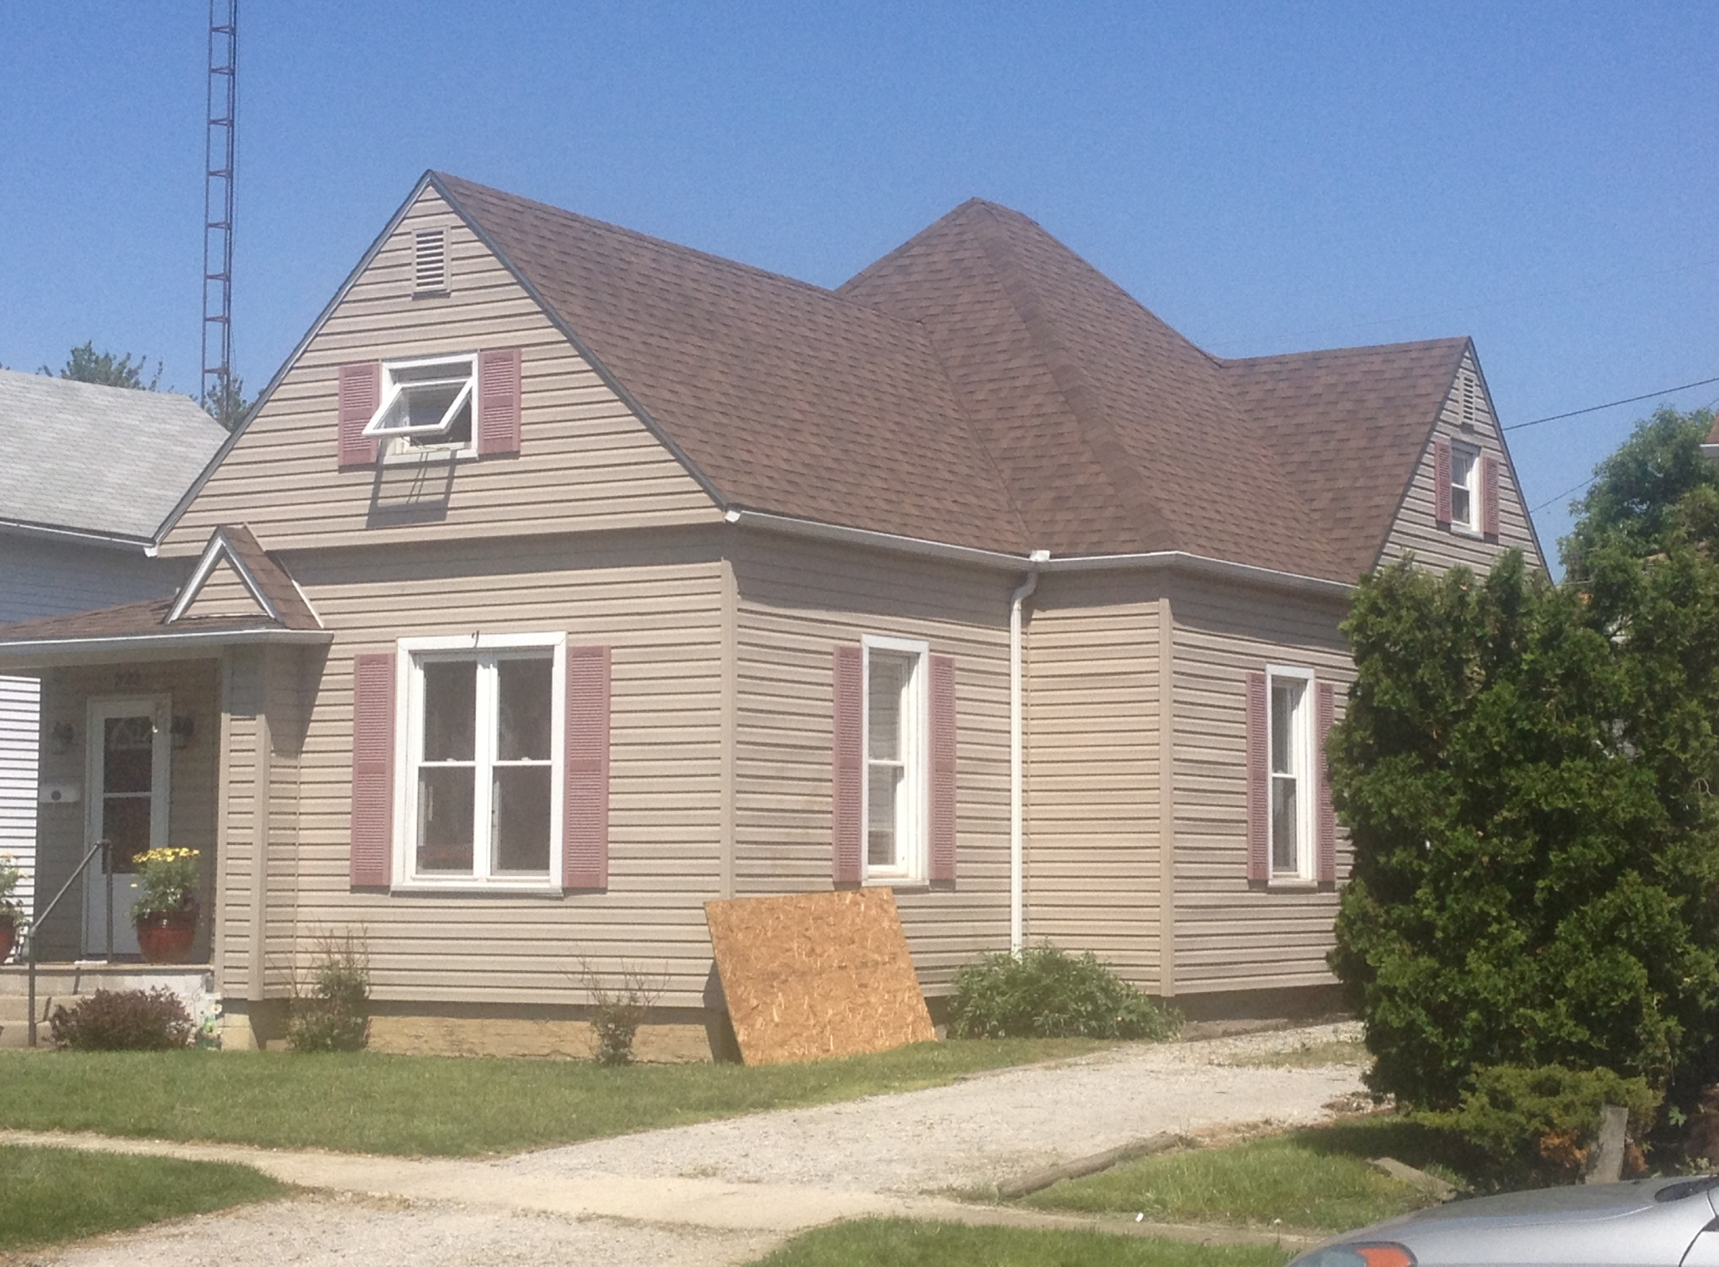
Pure Renovations
Project Profile
Home Owner's Story
Reverse Side
This is
an after
photo
Shawn Huston
323 South High St.
Kenton, Ohio 45840
Ph. # 419-202-6219
Note: Additional photos of this project are
available upon request.

Slide 11
Shawn Huston
323 South High St. ∙ Kenton, Ohio 45840 ∙ Ph. # 419-202-6219
Shawn is a very successful high school football coach who recently moved to Springfield, Mo. Prior to his move he
was in the process of selling his house when he too allowed Pure Renovations to represent his claim. Shawn has
gone from thinking this is too good to be true to letting everyone know how the process worked for he and his
family. His home recently sold just after getting his new roof.
He had several shingles missing due to high winds in the area earlier this year. We were able to help
Shawn work through the process, which took a little time, but was well worth it in the end. His house has very
steep slopes and his water and gutter problems were solved. By the way, that was done at no additional cost because he asked us to help him in this area. We worked through the claims department to get him what he needed. The insurance company covered the entire cost and Pure Renovations completed the work.
Since this has occurred, Shawn currently participates in Pure Renovation’s referral program. He too seems to be
very happy and has introduced his next door neighbors to us. Several projects will stem from Shawn’s leap of faith
in trying something that he did not think would be worth the time and effort to explain. He will be the first to tell
you that it was a pleasant surprise when he received his totally free new roof. The new home owner, who received a life-time warranted roof, is also well pleased with the outcome and exceptional service from Pure Renovations.
Shawn is a very outgoing, well spoken, and very personable individual to get to know that will welcome your call.
He continues to own other properties in the Kenton area and has endorsed Pure Renovations as a quality-minded
business that has your best interest at heart first and foremost at all times.
Note: Photos of this project are available upon request. Call Pure Renovations 937-565-4910.

Slide 12
Pure Renovations
Project Profile
Todd Ray
334 North Detroit St.
Kenton, Ohio 43326
Ph. # 567-674-1954
←
This before picture
shows the damage that Todd’s house sustained
←
←
←
←
Note:
Additional photos of this project are
available upon request.
Home Owner's Story
Reverse Side

Slide 13
Todd Ray
334 North Detroit St. ∙ Kenton, Ohio 43326 ∙ Ph. # 567-674-1954
Todd is in the process of receiving his new roof. Due to the recent intermittent rains in the area his repairs are still in motion and should be completed by the end of the week.
Of the many clients we have helped over the years, Todd’s comment was one of the most memorable. He said, when first approached about the process, “If I’m not obligated to spend any money, then why wouldn’t I want to sign up and begin the process?" From that moment on we have worked with Todd step by step.
He’s now an advocate of the Pure Renovation service that has been extended to him. We recently placed a sign out in front of his house for 30 days. He feels without our services that his roof would still be leaking and in need of repair, especially in light of the amount of rain this year has brought. We met his insurance adjuster on site and actually performed the inspections and estimating for his insurance adjuster due to the severity of the multiple slopes involved in his three-story home.
Todd’s insurance company is Farmers Mutual. He works 2nd shift so be mindful if you were to contact him to discuss his good fortune regarding his full roof replacement, which Pure Renovations has been assigned to complete.
Note: Photos of this project are available upon request. Call Pure Renovations 937-565-4910.

Slide 14
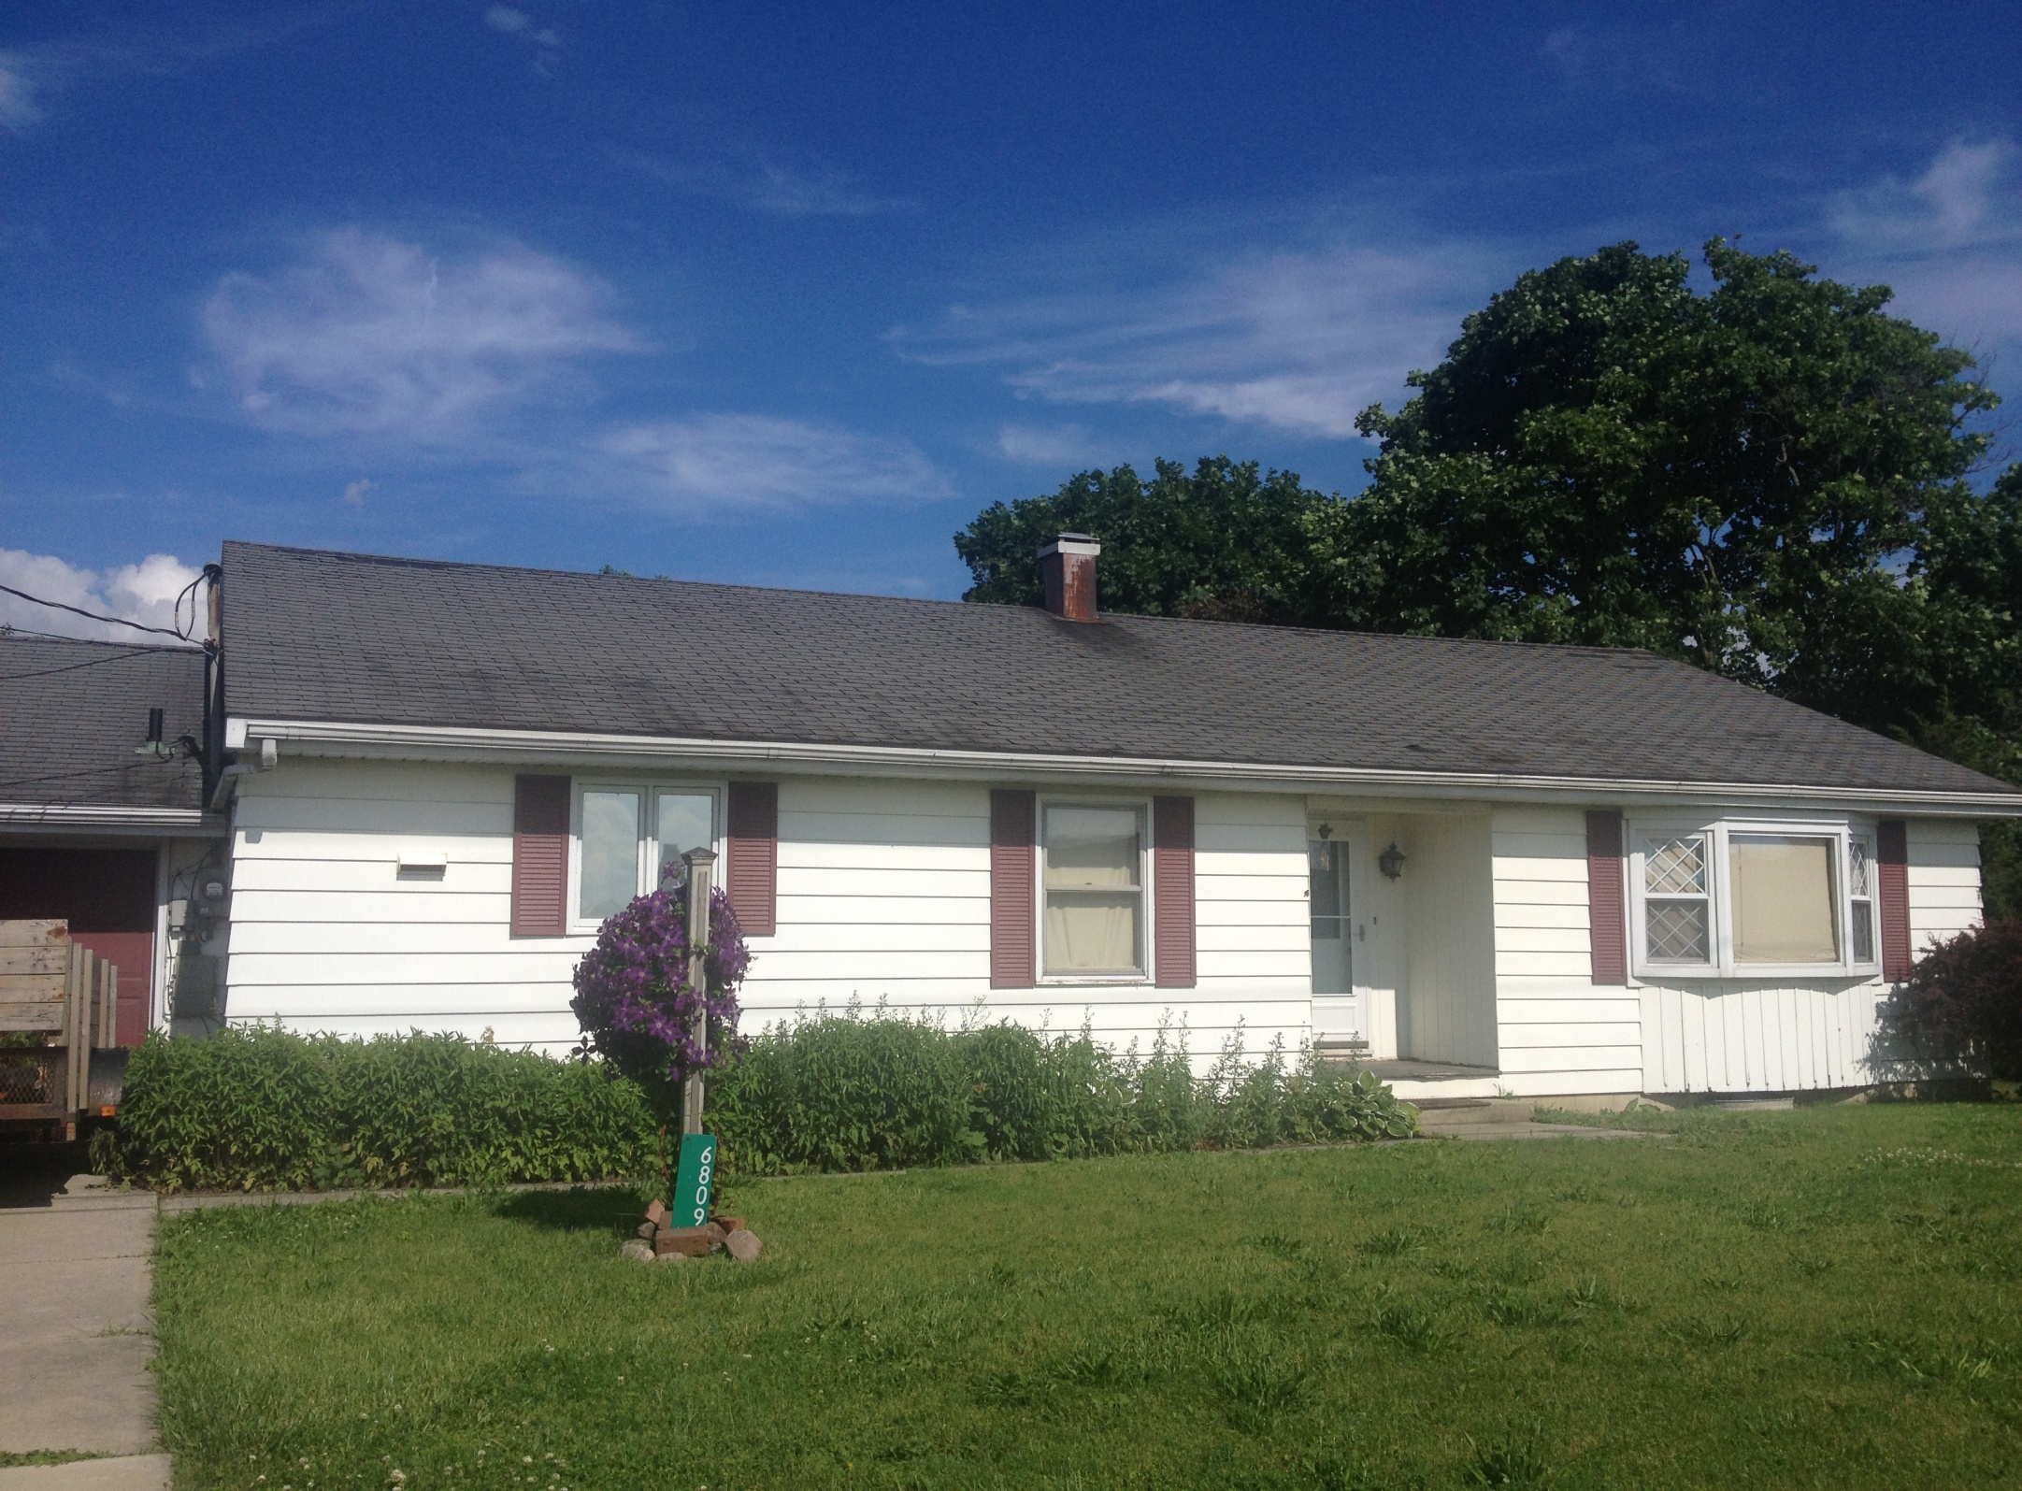
Home Owner's Story Reverse Side
Pure Renovations Project Profile
Bill Mercer
6809 County Road 236
Findlay, Ohio 45840
Ph. # 567-674-1954
←
←
←
Note:
Additional photos of this project are
available upon request.
This before picture
shows the damage that Bill's house sustained

Slide 15
Bill Mercer
6809 County Road 236 ∙ Findlay, Ohio 45840 ∙ Ph. # 567-674-1954
Bill’s process initially ran into trouble. A year or so earlier he filed a claim regarding a fence on his property. It was denied by his insurance company. This year, after severe winds hit early in February and most recently in April, Bill was contacted by Pure Renovations to possibly help him submit a new claim associated with weather related damage he incurred on his roof.
After over an hour delay in arriving at Bill’s house, the adjuster (evidently having a bad day) was reluctant to even get on the roof to inspect the damage. This individual was determined to force the policy holder to make their own repairs. The adjuster would not recommend covering anything beyond his deductable. We went to bat for Bill that afternoon and the following day. We conducted our own independent quantitative inspection for there was clearly wind damage. We made our case before the adjuster. Based upon our experience in the industry we were able to reverse the denied claim and reinstate the file as being on going awaiting further details and the photos which we took the following day on his behalf. Within three days, Bill was notified that instead of getting a couple bundle of shingles at his expense, he had been approved to receive an entire roof replacement.
Bill will affirm without Pure Renovation services, he would be spending money out of his own pocket to repair a roof that was damaged and quickly failing with only a few years left. This took some time and effort and required great detail but the reversal in outcome worked in the best interest of Bill and his family. They saved close to $7,500.00
Due to the recent intermittent rains in the area his repairs are in process and should be completed within a week or two. He’s been fully funded on the project with his first check from State Farm arriving last week. We will help Bill upon completion of the roof by submiting all necessary forms to insure that he receives his depreciation check currently being held by State Farm.
Note: Photos of this project are available upon request. Call Pure Renovations 937-565-4910.

Slide 16
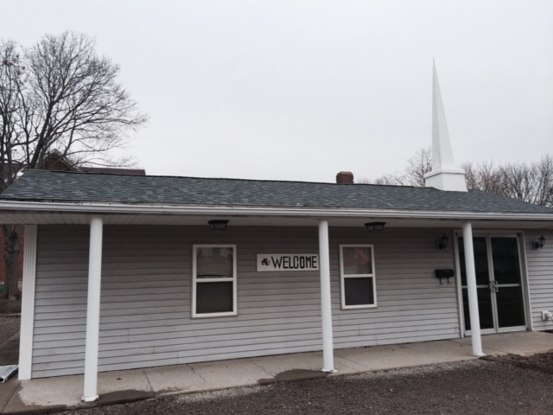
Pure Renovations
Project Profile
This is
an after
photo
Property Owner’s Story
Reverse Side
400 Ludlow Road
Bellefontaine, Ohio 43311
Ph. # 937-441-1893
Pastor Shelley Stephenson
Note:
Additional photos of this
project are available upon request.

Slide 17
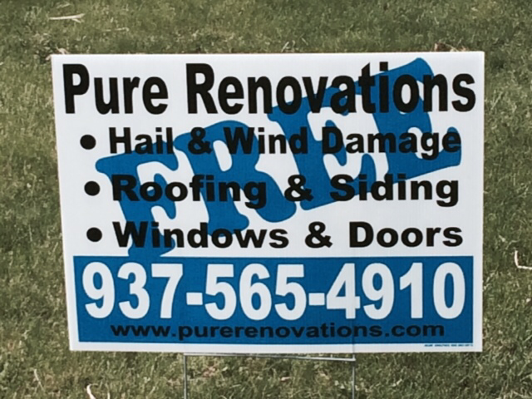
Pastor Shelley Stephenson
400 Ludlow Road ∙ Bellefontaine, Ohio 43311 ∙ Ph. # 937-441-1893
In the Pastor’s own words:
"At first I thought Pure Renovations was too good to be true, but they were an answer to prayer. We kept trying to keep up with the leaks by patching the roof here and there just to get by because, as a small church, we couldn't even afford the insurance deductible.
Pure Renovations made the process so easy by meeting with the adjuster for us, as our representative, so that we had the best chance at getting a fair shake at having our claim truly addressed and taken care of.
The bottom line is that we got a brand new roof and interior repairs for absolutely free. They are a company that is true to their word. That meant a lot to us."
Senior Pastor, Shelley Stephenson

Slide 18
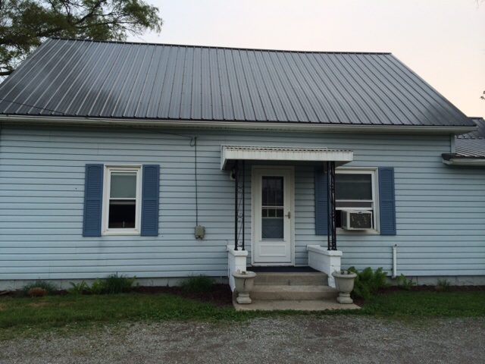
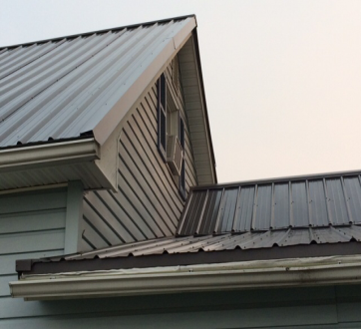
Property Owner’s Story
Reverse Side
Pure Renovations: Project Profile
This is
an after
photo
Don & Judy Patton
10889 CR 102
Belle Center, Ohio 43310
Ph. # 937-464-3162
Note: Additional photos of this project are available upon request.

Slide 19
Don and Judy Patton
10889 CR 102 ∙ Belle Center, Ohio 43310 ∙ Ph. # 937-464-3162
Don and Judy Patton are long-time residents of Logan County. This is one of several properties they own and rent out. Their roof received hail and wind damage earlier this year and upon learning about the good fortune of Christ Covenant Church in Bellefontaine, they decided to call Pure Renovations to see if they could represent them in filing their claim too.
We met with the adjuster and their insurance company came through. Pure Renovations worked out a reasonable deal for the Patton's because they wanted to put a metal roof on their house to match an existing small section of their extended roof.
They are well pleased with the results and efforts made in representing them in their insurance claim. Don has said in the future, based upon the quality and speed which the project took on, that he and Judy have no reservations what so ever in calling Pure Renovations in the future for any other projects that may come up.
It’s worth noting that Don was aware of what Pure Renovations was capable of but until they experienced it first hand, they too were skeptics. Not so any more. Call Don or Judy for they will elaborate about the process and put your mind to ease based upon Pure Renovations’ performance, representation, and quality installation.
Note: Photos of this project are available upon request. Call Pure Renovations 937-565-4910.

Slide 20
The Pure Renovations pledge:
We are committed to the highest quality standards set forth in the building industry. We strive for excellence in representing and fulfilling our client’s needs to the fullest.
We encourage you to do your own research and then experience for yourself becoming a part of those who have utilized our services and are now life long friends, partners, and connected advocates of the Pure Renovation community.
Sincerely,
John Fout Pure Renovations is celebrating
Founder/Owner it’s 15th year in business.
Note: The clients profiled in this presentation are a small segment of randomly selected narratives of those who have experienced the Pure Renovations’ process. It is ever growing. Each week more pictures, additional case stories, and testimonials will be posted.
1555 County Road 25 South ∙ Bellefontaine, Ohio 43311 ∙ (937) 565-4910
www.purerenovations.com

